Slide 1
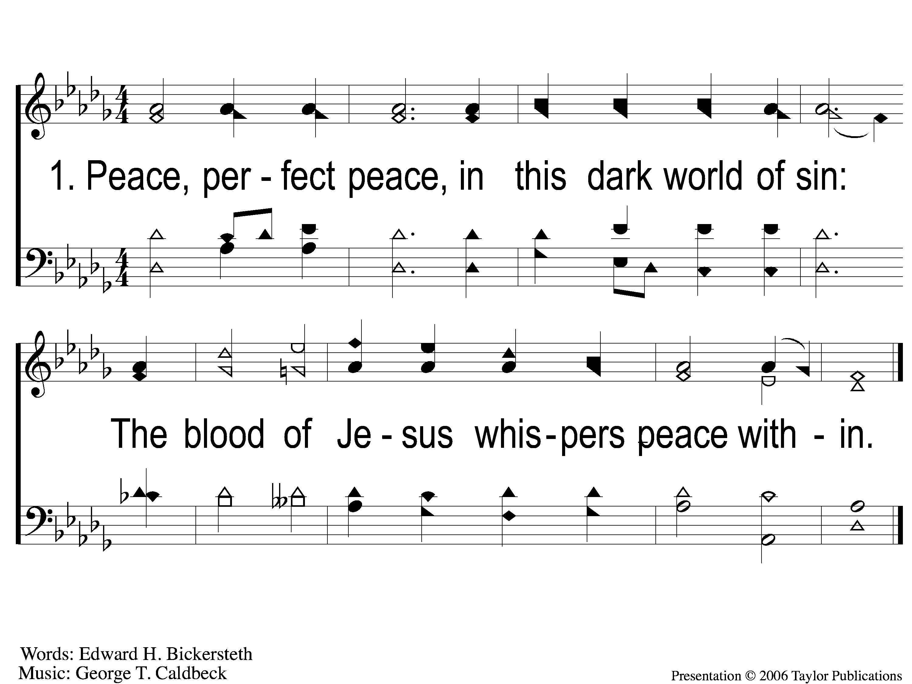
1 Peace Perfect Peace
Peace, Perfect Peace
123

Slide 2
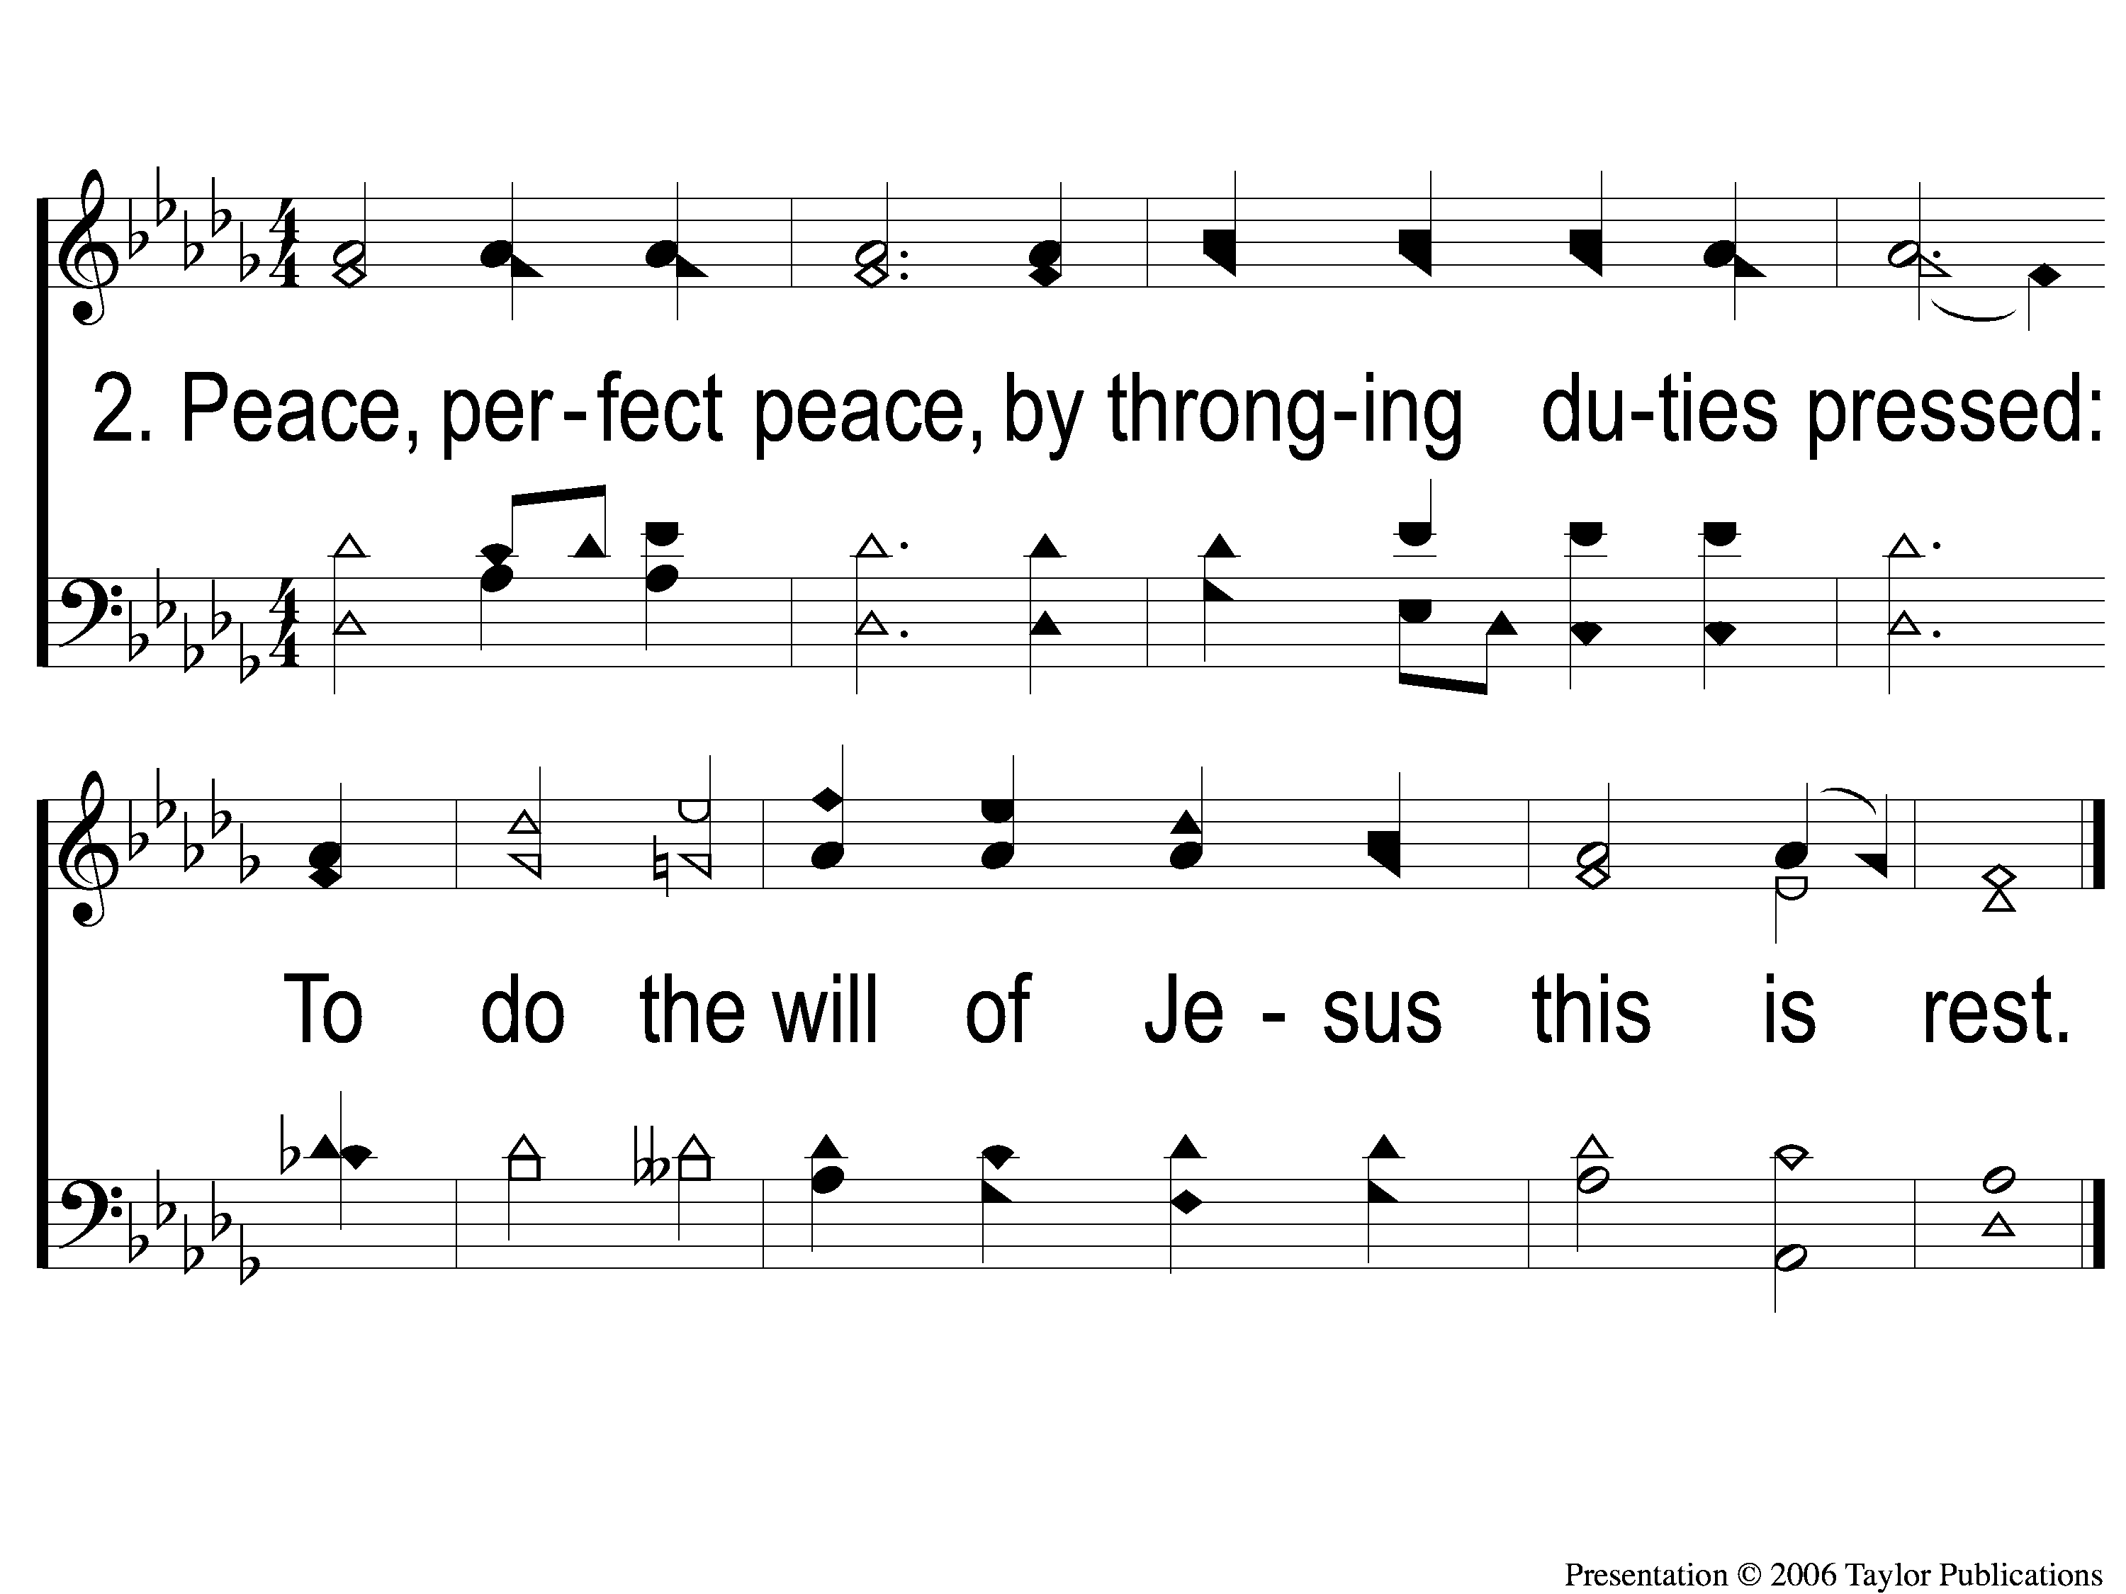
2 Peace Perfect Peace
Peace, Perfect Peace
123

Slide 3
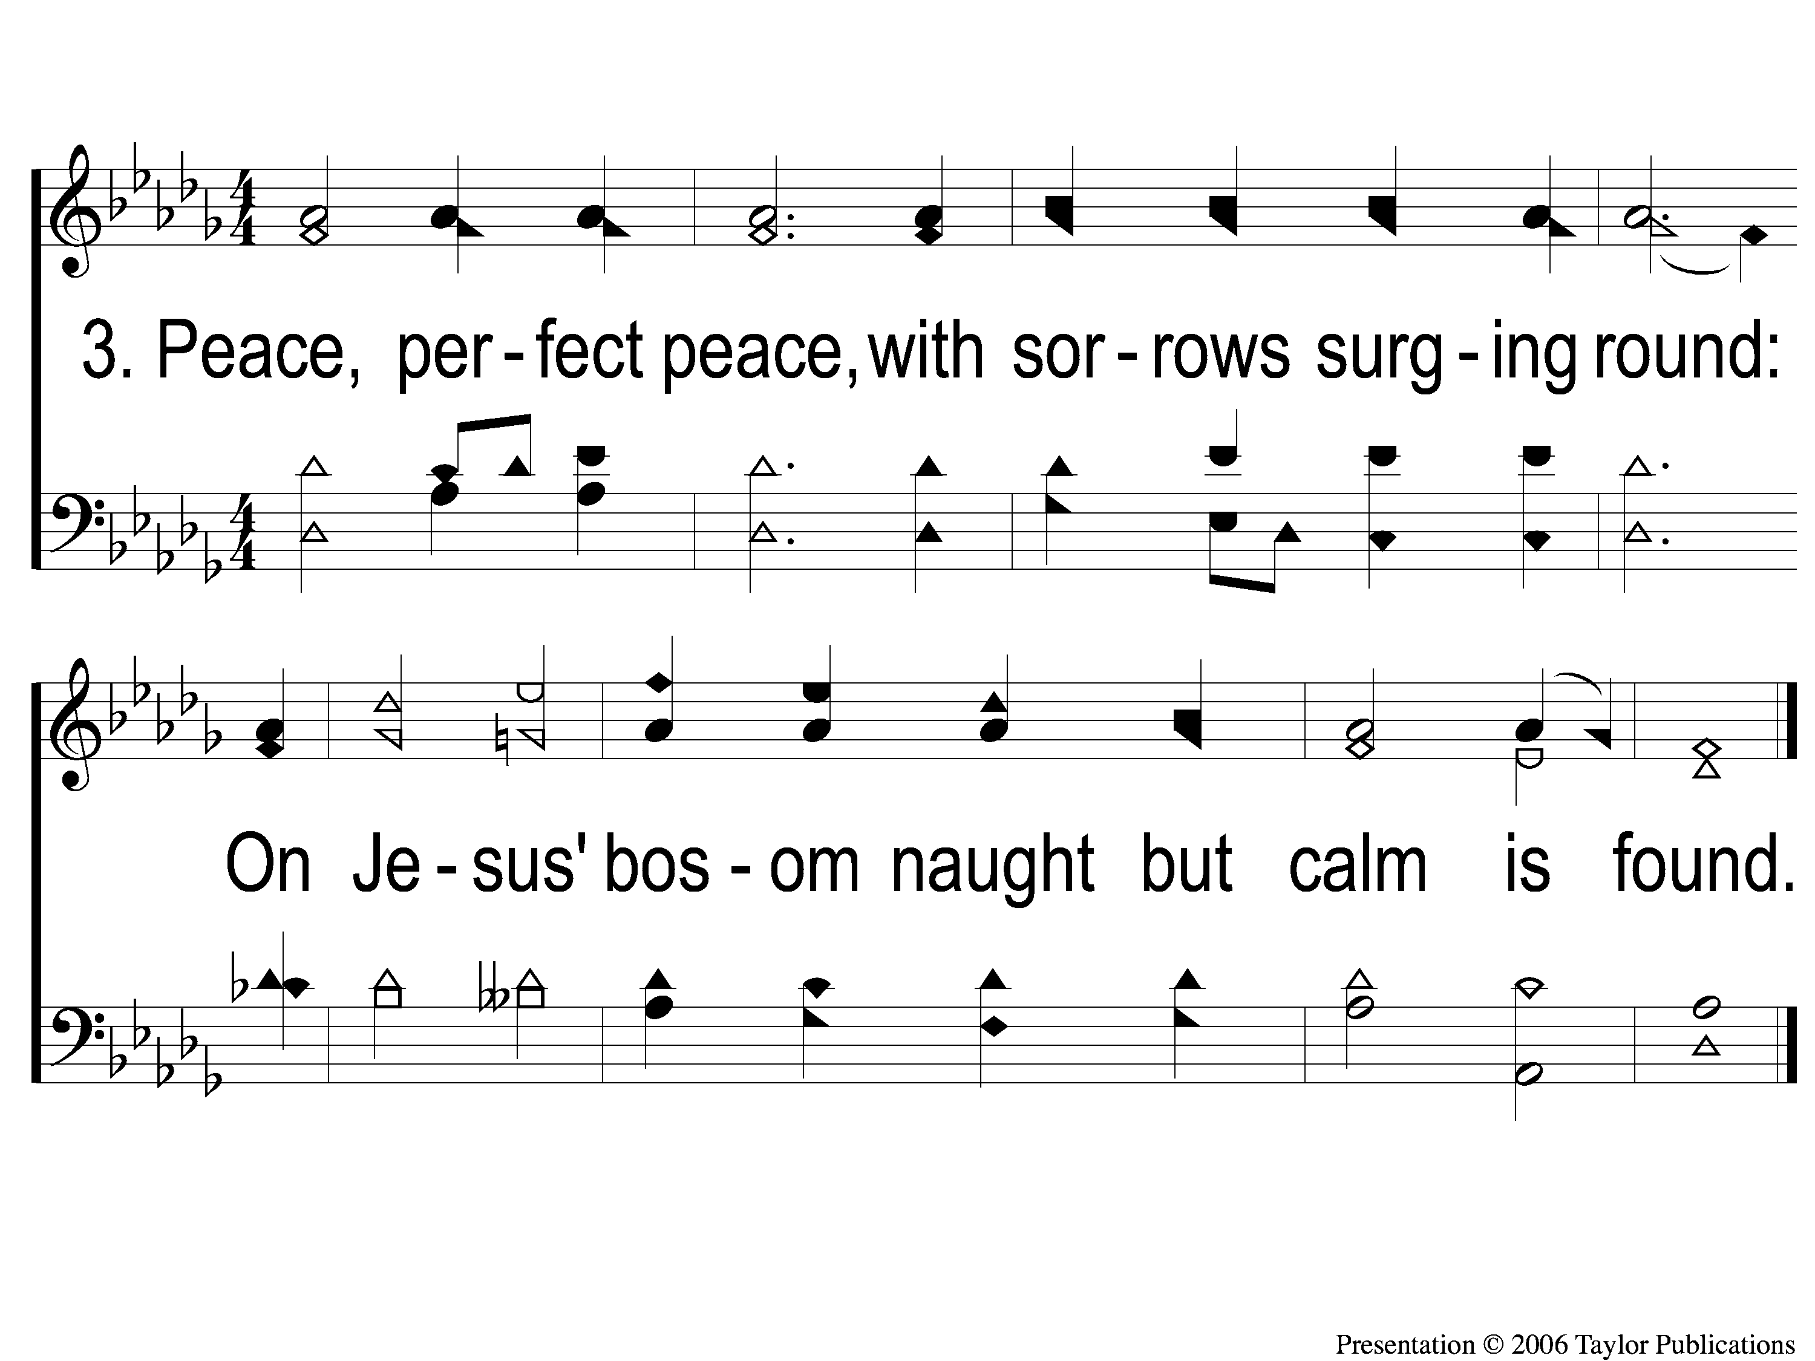
3 Peace Perfect Peace
Peace, Perfect Peace
123

Slide 4
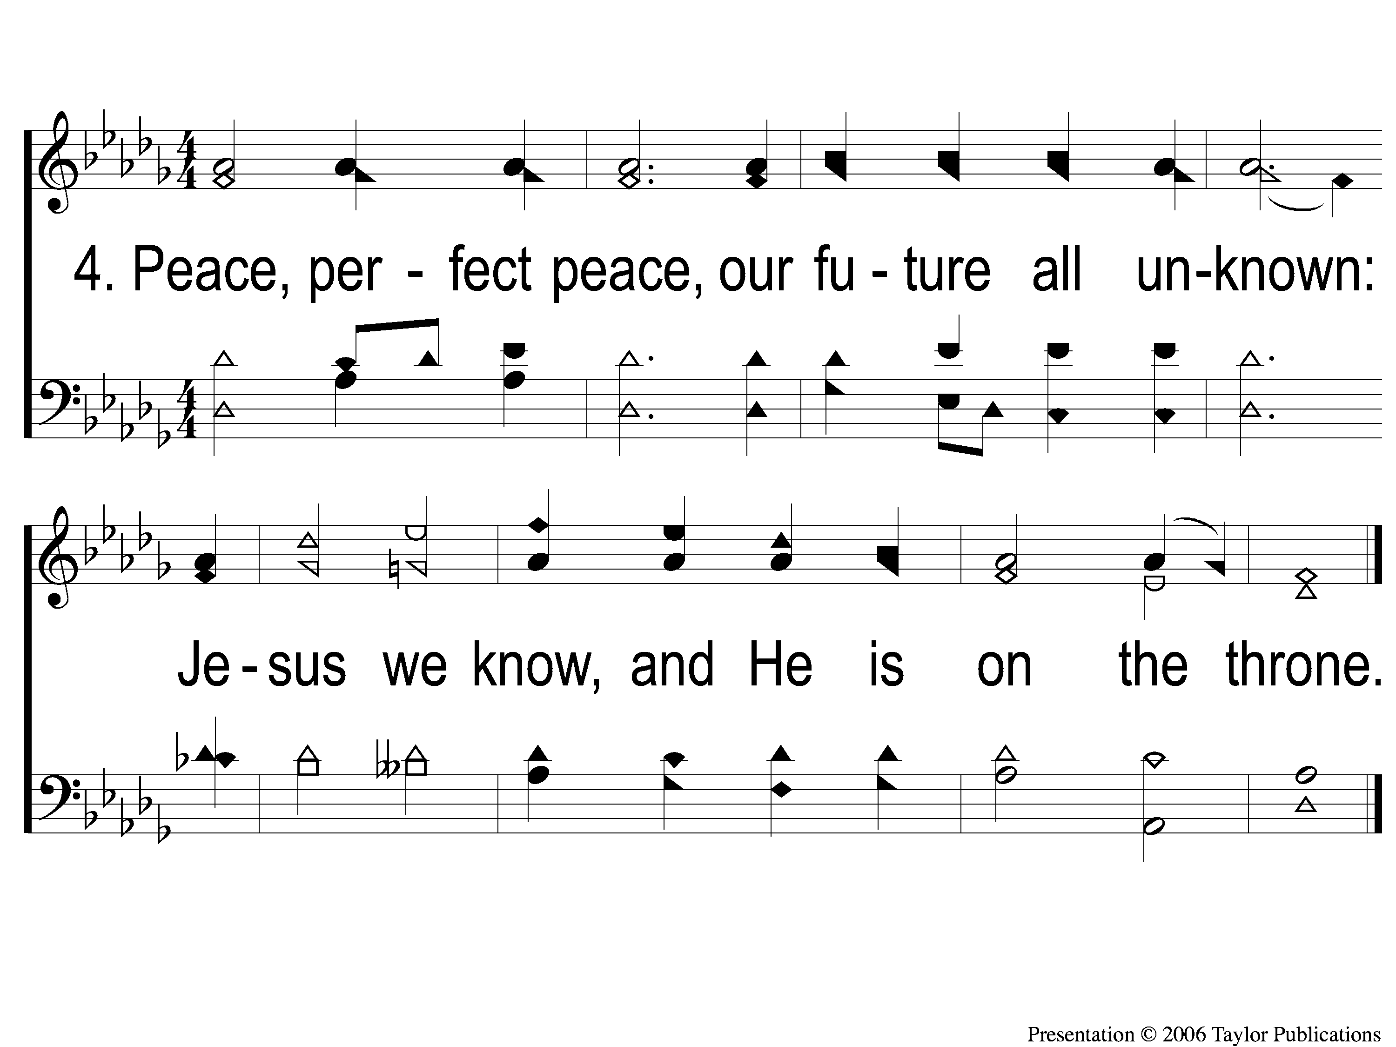
4 Peace Perfect Peace
Peace, Perfect Peace
123

Slide 5
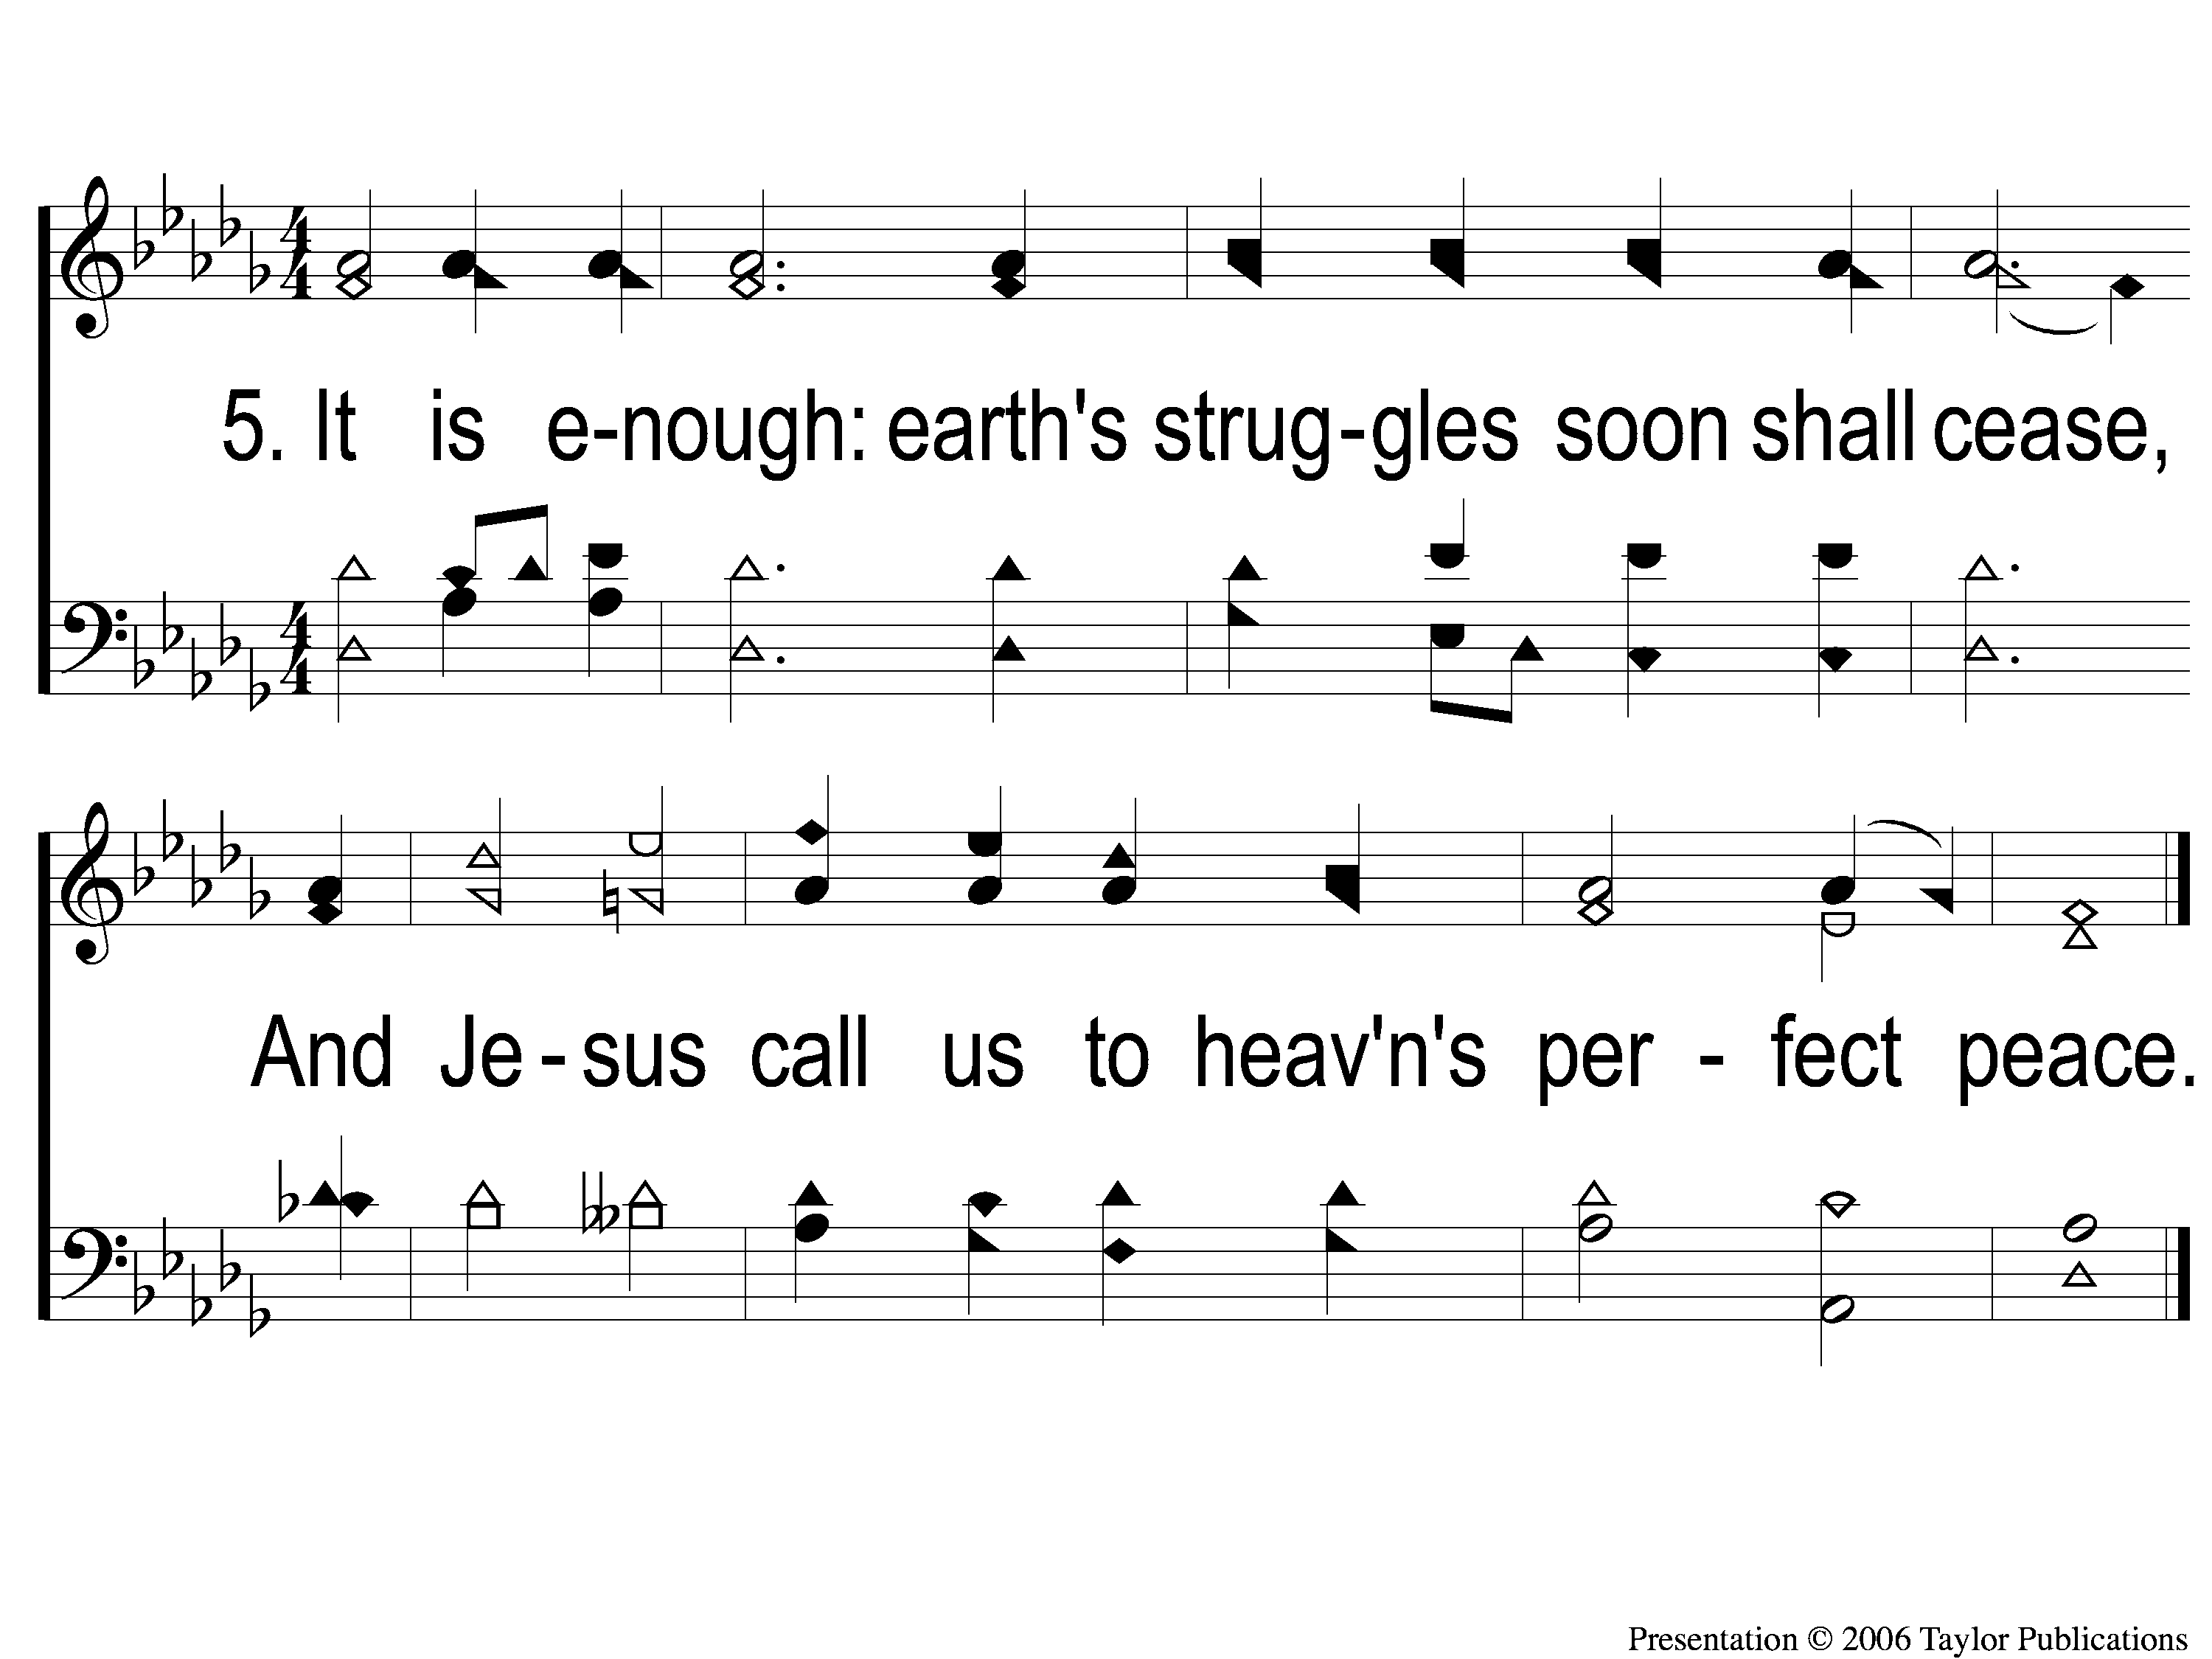
5 Peace Perfect Peace
Peace, Perfect Peace
123

